Slide 1
Oral Health for Mothers, Infants and Children
Dr. Tammy Gierke Button, DDS, MSD
Pediatric Dentist
Executive Director, Southshore Skipping Stones
Dr. James R. Miller, DDS, MSD, PhD
State Oral Health Director
Indiana State Department of Health
December 2021
Notes:
1

Slide 2
Disclaimer
ISDH Oral Health Program Disclaimer for courses or presentations:
The information provided in this course or presentation does not, and is not intended to, constitute dental, medical, or legal advice; instead, all information, content, and materials available in this course or presentation are for general informational purposes only. You should contact an outside dentist, physician, or attorney to obtain dental, medical, or legal advice and prior to acting, or refraining from acting, on the basis of information contained in this course or presentation.
All liability with respect to actions taken or not taken based on the contents of this course or presentation are hereby expressly disclaimed.

Slide 3
Maintaining Good Oral Health during the Perinatal Period
This course:
Provides oral healthcare professionals with information about how expectant mothers, new mothers, infants and children can maintain good oral health; and
Focuses primarily on the prevention of tooth decay, with a few comments about preventing malocclusions.

Slide 4
MAJOR TOPICS
Pregnancy and Oral Health
Oral Hygiene
Fluoride
Dental Home
Nutrition
Oral Habits
Importance of Baby Teeth

Slide 5
Time periods to consider
Mother
Expectant mother
New mother
Developing child before birth
Infant and young child
Infant before baby teeth
Infant and children with baby teeth
Transition from baby teeth to permanent teeth

Slide 6
ORAL HEALTH
* Mothers
* Infants
* Children

Slide 7

Prenatal Oral Health Care
Resources
National Maternal and Child Oral Health Resource Center
2012. Oral Hhttps://www.mchoralhealth.org/PDFs/OralHealthPregnancyConsensus.pdf
em Washington, DC: National Maternal and Child Oral Health

Slide 8
Changes to oral health
of mother during pregnancy
Hormonal changes
  Pregnancy gingivitis
    Most common oral disease during pregnancy
    Gums more sensitive to dental plaque, which can cause swelling and bleeding
  Salivary changes – excess saliva or dry mouth
  Pregnancy tumors of the gingiva – growth that subsides after pregnancy
  Metallic or sour taste
  Mobile teeth not related to periodontal disease

Slide 9
Changes to oral health
of mother during pregnancy
Nausea and vomiting
  Nausea may cause increased intake of antacids that contain sugar and add to the risk of dental caries.
  Vomiting can produce erosion of teeth, if one brushes too soon after vomiting.
Dietary changes
  Odd cravings may lead to increased consumption of foods with carbohydrates and sugars, adding to the risk of caries.

Slide 10
Changes to oral health
of mother during pregnancy
Dental Caries
  Pregnancy does not weaken teeth
  or necessarily predispose women to tooth decay.
  Pregnancy does not cause minerals to be removed from teeth.
  However, changes in dietary habits, frequent acid challenges and hormonal changes may add to the risk of dental caries during pregnancy.

Slide 11
Dental caries, periodontal disease
and pregnancy outcomes
Tooth decay and gum disease are bacterial and/or inflammatory diseases.
Any infection or inflammation during pregnancy can be a concern for the health and safety of the mother and her unborn child.

Slide 12
Dental caries
and pregnancy outcomes
Tooth decay during pregnancy may influence pregnancy outcomes via inflammation pathways and has been associated with:
Pre-term birth;
Low birth weight babies; and
Pre-eclampsia.
Madhu, Wagle et. al., Dental Caries and Pre-term Birth: A Systemic Review and Meta-Analysis. BMJ Open 2018; 8: e018556.

Slide 13
Periodontal disease
and pregnancy outcomes
Gum disease during pregnancy may influence pregnancy outcomes via inflammation pathways and has been associated with:
Pre-term birth;
Low birth weight babies; and
Pre-eclampsia.
Vivares – Builes, Annie et. al., Gaps in Knowledge about the Association between Maternal Periodontal Status and Adverse Obstetric outcomes. An umbrella Review. J Evid Base Dent Pract 2018: 1-27.

Slide 14
Pregnancy Outcomes - Caveats
Associations may be merely a statistical finding and do not necessarily indicate a cause and effect relationship between a purported risk factor and a disease.
There is still a lot of uncertainty about whether dental caries and/or periodontal disease actually causes adverse pregnancy outcomes.

Slide 15
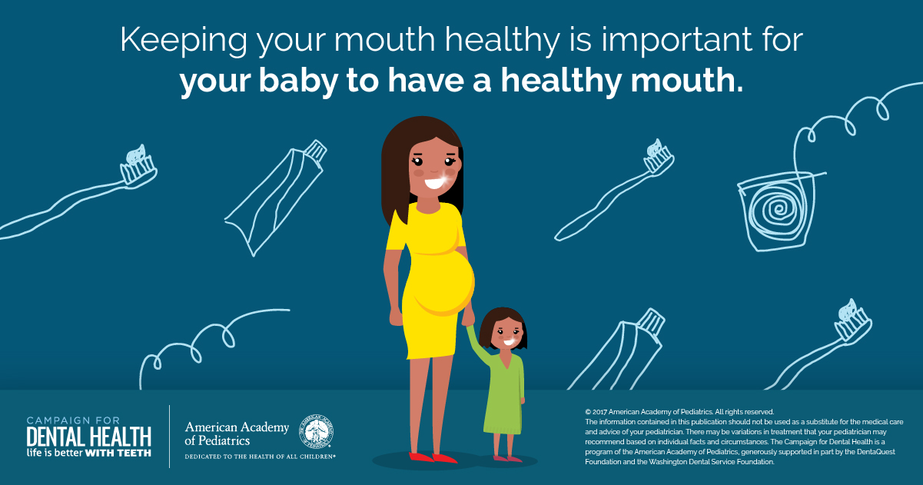
A more certain relationship

Slide 16
Poor oral hygiene during pregnancy can adversely effect teeth of newborn
If an expectant mother has poor oral hygiene, then decay-causing bacteria can multiply.
When a baby is born, the mother can pass these bacteria from her mouth to the infant, adding to the risk of the infant developing tooth decay.
Note: If a new mother has help from a caregiver, poor oral hygiene in that caregiver can also put an infant at risk of tooth decay.
Smith, Daniel. Caries vaccines for the 21st Century. Journal of Dental Education 67(10): 1130-1139.

Slide 17

Poor oral hygiene by the expectant mother can increase the number of dental caries causing bacteria

Slide 18
Poor oral hygiene during pregnancy can adversely effect teeth of newborn
Babies are not born with cavity causing oral bacteria.
However, if the mother or primary caregiver has high levels of cavity causing bacteria, these can be passed to the baby.
The higher the level of these bacteria in the mother’s or primary caregiver’s mouth, the more likely her baby will develop dental decay.
Smith, Daniel. Caries vaccines for the 21st Century. Journal of Dental Education 67(10): 1130-1139.

Slide 19
Poor oral hygiene during pregnancy can adversely effect teeth of newborn
If high levels of cavity causing bacteria are passed to the baby, then once the baby teeth erupt they are susceptible to decay.
If the level of these bacteria is high enough the baby teeth can start to develop caries immediately.
Caries can progress very quickly to dental decay and cavities; some parents comment that the decay seemed to appear overnight.
Smith, Daniel. Caries vaccines for the 21st Century. Journal of Dental Education 67(10): 1130-1139.

Slide 20
Cavity causing bacteria passed to infant by mother can put baby’s teeth at risk of decay

Slide 21
Pregnancy Outcomes
The good news is that good oral hygiene, other preventive steps and normal dental care can reduce or even eliminate the risk of passing these bacteria to an infant.
Furthermore, normal oral hygiene activities and other preventive steps, as well as routine dental care are considered safe during pregnancy.

Slide 22
Good oral hygiene during pregnancy can positively effect teeth of newborn
If a mom takes good care of her oral health during pregnancy, she has less decay-causing bacteria to pass to her newborn, which reduces the risk of the infant developing tooth decay.

Slide 23
Important Messages
If an expectant mother practices good oral health care during her pregnancy, she can improve her oral health and improve the chances of her new baby having good oral health.
Once the baby is born, it is important that the mother continues her own oral health care and institutes appropriate oral health care for her new baby.

Slide 24
Basics of Prevention
Oral Hygiene
    Brushing
    Flossing
Fluoride
    Community water with fluoride
    Toothpaste
    Fluoride varnish
    Fluoride supplementation
Dental Home
    During and after pregnancy
    Finding a dental home
Notes:
24

Slide 25
Prenatal Oral Health Care for Expectant Mom
Oral Hygiene
  Brush teeth with fluoridated toothpaste twice a day.
    If toothpaste causes nausea, a different flavor and/or reduced amount of toothpaste may be used.
    If toothpaste cannot be tolerated, it can be eliminated; but, brushing should be continued without the toothpaste.
    The toothbrush should be replaced every 3 or 4 months, or more often if the bristles are frayed.
    The toothbrush should not be shared with an infant or anyone else.
  Clean between teeth daily with floss or an interdental cleaner.
  Rinse every night with an over-the-counter fluoridated alcohol-free mouth rinse.
      Oral Health Care During Pregnancy Expert Workgroup. 2012. Oral Health Care During Pregnancy: A National Consensus Statement. Washington, DC: National Maternal and Child Oral Health Resource Center.
Notes:
25

Slide 26
Prenatal Oral Health Care for Expectant Mom
Oral Hygiene
  After eating, the expectant mom can use a xylitol product to enhance oral hygiene by:
    Chewing a xylitol-containing gum; or
    Using other xylitol-containing products, such as mints, which can help reduce bacteria that can cause tooth decay.
  If the expectant mother has morning sickness and vomiting:
    The mom can rinse her mouth with a teaspoon of baking soda
    in a cup of water to stop acid from attacking her teeth;
    She can then brush her teeth once the acid has been neutralized.
      Oral Health Care During Pregnancy Expert Workgroup. 2012. Oral Health Care During Pregnancy: A National Consensus Statement. Washington, DC: National Maternal and Child Oral Health Resource Center.
Notes:
26

Slide 27
Prenatal Oral Health Care for Expectant Mom
Prevention with systemic fluoride
  Community Water Fluoridation
      The optimal level of fluoride maintained in community water systems is considered safe for both the expectant mother and developing child.
      When an expectant mother drinks fluoridated water it will help prevent her from getting dental decay.
      However, current thinking is that consumption of community fluoridated water by an expectant mom does not directly prevent decay in a newborn.
Takahashi R, Ota E, Hoshi K, Naito T, Toyoshima Y, Yuasa H, Mori R, Nango E. Fluoride supplementation (with tablets, drops, lozenges or chewing gum) in pregnant women for preventing dental caries in the primary teeth of their children. Cochrane Database of Systematic Reviews 2017, Issue 10. Art. No.: CD011850. DOI: 10.1002/14651858.CD011850.pub2.
Notes:
27

Slide 28
Prenatal Oral Health Care for Expectant Mom
Prevention with systemic fluoride
  Fluoride Supplementation – adding fluoride to water to bring the fluoride level to an optimum level
      If the fluoride level in the mother’s water is low, fluoride supplementation may improve her oral health, which as we have seen can help prevent decay in a newborn.
      However, current thinking is that consumption of fluoride supplemented water by an expectant mom does not directly prevent decay in a newborn.
Takahashi R, Ota E, Hoshi K, Naito T, Toyoshima Y, Yuasa H, Mori R, Nango E. Fluoride supplementation (with tablets, drops, lozenges or chewing gum) in pregnant women for preventing dental caries in the primary teeth of their children. Cochrane Database of Systematic Reviews 2017, Issue 10. Art. No.: CD011850. DOI: 10.1002/14651858.CD011850.pub2.
Notes:
28

Slide 29
Community Water Fluoridation
The Indiana State Department of Health Water Fluoridation Program thinks there is strong evidence to support the fluoridation of water in a community water system to help prevent decay in the population served by that system.
The ISDH encourages communities to seriously consider the benefits of maintaining the recommended level of fluoridation in a community water system to help prevent tooth decay.

Slide 30
Community Water Fluoridation
The decision concerning whether a community fluoridates its water to help prevent dental decay is made by local officials in Indiana.
If a community decides to fluoridate its water, then the Division of Environmental Public Health from the Indiana State Department of Health will provide staff that monitors and inspects the amount of fluoride added to the water and the maintenance of the equipment used to add the fluoride.

Slide 31
Indiana State Department of Health
Water Fluoridation Program
Information pertaining to water fluoridation can be found at the following websites:
https://www.in.gov/isdh/23287.htm
https://www.in.gov/isdh/24524.htm

Slide 32
Prenatal Oral Health Care for Expectant Mom
Prevention with topical fluoride
  Toothpaste
    As mentioned previously, an expectant mom should brush her teeth, at a minimum, twice a day with fluoridated toothpaste.
  Fluoride Varnish – Consult a dentist
    Fluoride varnish may also be used during pregnancy in expectant moms at high risk for dental caries.
    It can also be use to prevent enamel erosion due to frequent bouts of vomiting.
Giglio JA, Lanni SM, Laskin DM, Giglio NW. Oral health care for the pregnant patient. J Can Dent Assoc 2009;75(1):43-8.
Notes:
32

Slide 33
Prenatal Oral Health Care for Expectant Mom
    The American College of Obstetrics and Gynecologists states,
    … to potentiate general health and well-being, women should routinely be counseled about the maintenance of good oral health habits throughout their lives as well as the safety and importance of oral health care during pregnancy.
Committee on Health Care For Underserved Women: Oral Health Care During Pregnancy and Through the Lifespan
Notes:
33

Slide 34
Prenatal Oral Health Care for Expectant Mom
Dental Home
        An expectant mom can:
        Call and verify that her dentist provides care during pregnancy;
        Let the dental office know how far along she is and inform office if she is considered a high risk pregnancy;
        Get a clearance form from her OB for dental treatment; some OB’s provide this at first visit; and
        Ask for a referral to a dentist who can provide this care.
Notes:
34

Slide 35
Preparing for New Baby
Dental Home
The American Academy of Pediatric Dentistry (AAPD) and the American Academy of Pediatrics (AAP) recommend that,
Children have their 1st dental visit when the 1st baby tooth erupts, but no later than the 1st birthday.
Tips for finding a dentist for a newborn
Many general and family dentists do not see infants and young children.
If so, a general or family dentist may be able to provide the expectant mother a referral to a pediatric dentist for the baby.
To find a pediatric dentist for a newborn, an expectant mom can also visit aapd.org.
Notes:
35

Slide 36
Preparing for New Baby
Dental Home
  To find a pediatric dentist for a new baby, an expectant mom can find a listing of pediatric dentists at: aapd.org, and then do the following:
    Call several pediatric dentists and ask if they are taking new patients;
    Ask the office policy concerning dental insurance and if they accept your insurance; and
    Ask for an office tour to meet the dentist and staff.
Notes:
36

Slide 37
Postnatal Oral Health Care for
New Mom
  After delivery of the new baby, a new mom should continue brushing with fluoride toothpaste twice daily and flossing daily.
    This is still a critical time for optimal oral health.
    Good oral hygiene in the mom helps prevent the growth of cavity-forming bacteria in her mouth and diminishes any such bacteria she might pass to her new baby.
Notes:
37

Slide 38
Oral Health Care for Infant
Before Baby Teeth
  The time before baby teeth erupt is a critical time.
  Oral hygiene for the baby, before teeth erupt, will help prevent bacteria from colonizing early in the mouth.
  This will help reduce the risk of dental decay developing once the teeth erupt.
  Wiping a baby’s mouth out daily helps to get baby and parent used to cleansing the oral cavity.
  In addition to routine cleaning, cleaning should also be done after each feeding.
  Also, clean the pacifier.
Notes:
38

Slide 39
Oral Health Care for Infant
With Baby Teeth
Oral hygiene for a baby with teeth
    With the eruption of the 1st baby tooth:
    A mom should switch from wiping the baby’s mouth out with an infant washcloth to using a toothbrush for oral hygiene;
    Brush teeth, gums, cheeks and tongue;
    Routine brushing is twice a day – morning and last thing before bed; and
    Also, should try to brush after each feeding.
    As soon as there are any teeth that touch each other,
    it is recommended to begin flossing
Notes:
39

Slide 40
Oral Health Care for Infant
With Baby Teeth
Oral hygiene for a baby with teeth
    A parent should brush a child’s teeth while the child is gaining the manual dexterity to brush on his/her own teeth.
    Children frequently start trying to brush their own teeth at about the same time they start trying to cut their food with a knife and fork.
    Regardless of how soon a child appears to be brushing well, a parent should continue to brush the child’s teeth with fluoridated toothpaste until age 6-7 years.
Notes:
40

Slide 41
Oral Health Care for Infant
With Baby Teeth
Systemic fluoride for a baby with teeth
  Community water fluoridation
  Fluoride supplements
    A dentist can determine if supplementation is necessary.
    Supplementation may continue until the child is aged 16 years and the 3rd molars are finished forming within the bone and gums.
Notes:
41

Slide 42
Oral Health Care for Infant
With Baby Teeth
Topical fluoride for a baby with baby teeth
  Toothpaste
    A smear/rice-size amount of fluoride toothpaste should be used twice a day with brushing. (AAPD)
    This amount of toothpaste will contain enough fluoride to work while not harming the baby when swallowed.
  Fluoride varnish
    The child’s dentist can talk to the mom about the possible use of fluoride varnish for the child, depending on child’s risk for dental caries.
Notes:
42

Slide 43
Oral Health Care for Infant
With Baby Teeth
Dental Home for a baby with baby teeth
  When and how often should the baby be taken to the dentist?
    Visit the dentist at the eruption of the 1st baby tooth or the 1st birthday, whichever occurs first.
    Appointments should be every six months, unless the dentist recommends a different schedule.
Notes:
43

Slide 44
Transition to Permanent Teeth
A very common misconception of many parents and caregivers is that:
“Baby teeth fall out so we aren’t worried about keeping them healthy. Once there are permanent teeth we will focus on these adult teeth…”
However, keeping baby teeth healthy is important for many reasons, including:
Dental caries is a multifactorial infectious bacterial disease and children are more likely to have decay in permanent teeth if they had decay in their baby teeth.
The permanent teeth erupt into the same environment as the baby teeth – nothing magically changes.
A good diet and oral hygiene habits developed during early childhood will carry over into childhood and adolescence.
Notes:
44

Slide 45
Transition to Permanent Teeth
Oral Hygiene
Newly erupted teeth may be at higher risk of developing caries, especially when there is a high caries risk. (AAPD)
When the first permanent tooth erupts (between ages 5-7 years, on average) parents should still be brushing for their child, especially at night, with fluoridated toothpaste.
Visits to a dentist allows the dentist to:
Evaluate the risk for dental caries;
Evaluate the need for fluoride varnish;
Evaluate the need for fluoride supplements;
Apply dental sealants; and
Perform a growth and development analysis of the teeth and face.
Notes:
45

Slide 46
Nutrition: Breastfeeding
Benefits:
  Reduces cavity formation up to age 12 months;
  Protects against malocclusion in primary dentition.
Risks:
  Nocturnal breastfeeding puts an infant at elevated risk of dental caries;
  Prolonged breastfeeding, longer than 12 to 24 months, puts a child at an elevated risk of dental caries.
Peres, et. Al. Breastfeeding and Oral Health: Evidence and Methodological Challenges. J Dent Res. 2018 Mar; 97(3):251-258.
Notes:
46

Slide 47
Nutrition for Infant
Before Baby Teeth
Feeding with Breast Milk or Formula
  The AAP recommends that for the first 6 six months, the baby should be fed only breast milk and formula.
  The baby’s mouth should be wiped out with an infant washcloth after each feeding.
Notes:
47

Slide 48
Nutrition for Infant
Before Baby Teeth
Bottle feeding
  The mother should avoid bottle propping or putting the baby in bed with a bottle.
  Only breastmilk or formula should be used in the bottle, unless other liquids are prescribed by the physician​​​.
  Wipe out baby’s mouth daily with an infant washcloth and after each bottle feeding.
Notes:
48

Slide 49
Nutrition for Infants and
Young Children
Bottle feeding
American Academy of Pediatrics (AAP) guidelines for phasing out the bottle state that,
  Bottles should be phased out between 12 and 24 months of age.
Notes:
49

Slide 50
Nutrition for Infants and
Young Children
Open Cup Introduction at Six Months
  Babies are encouraged to drink from an OPEN cup starting at 6 months of age, according to the AAP.
  Practice with only water – do not get baby used to sweetened beverages in a cup.
  Juice is not recommended for babies younger than
  1 year of age, unless specifically instructed by pediatrician.
Notes:
50

Slide 51
Nutrition for Infants and
Young Children
Sippy cups
  A toddler only needs to drink when thirsty or with meals.
  If a toddler holds on to a cup most of the day like a security blanket, they may end up overdrinking (and need more frequent diaper changes).
  Sippy cups are only meant for transition from bottle feeding to drinking out of regular cups.
  Water is the only liquid for a sippy cup in between meals!
Notes:
51

Slide 52
Nutrition for Infants and
Young Children
Sippy cups (continued)
  Frequently drinking milk, juices or sodas, which contain sugars, can lead to tooth decay because teeth are continually being bathed in sugary liquids that help bacteria grow.
  The child should not go to bed with a bottle or sippy cup
  Good rule: In between meals, a sippy cup should only contain water. The child should be offered the daily suggested servings of milk and juice at mealtime.
  The caregiver should keep track of sippy cup use.
Notes:
52

Slide 53
Nutrition for Infants and
Young Children
Solid Foods
  American Academy of Pediatrics (AAP) guidelines for feeding include to:
    Introduce solid foods around 6 months of age;
    Expose baby to a wide variety of healthy foods; and
    Offer a variety of food with different textures.
T
Note: These should be discussed with the pediatrician.
Notes:
53

Slide 54
Nutrition for Infants and
Young Children
EVERY BITE COUNTS:
NO ADDED SUGARS FOR KIDS 24 MONTHS OR YOUNGER!
What is added sugar?
  Additional sugars added to processed, packaged food and drinks while they are being made or at your table.
  Added sugar is easier to spot on nutrition labels. You also can find added sugar by reading the ingredients. It comes in many forms, including brown sugar, corn sweetener, corn syrup, high-fructose corn syrup, honey dextrose, fruit juice concentrates, invert sugar, malt sugar, molasses, raw sugar, turbinado and ingredients ending in “-ose.”
Why avoid added sugars?
  Eating and drinking too much added sugar puts kids at risk for obesity, tooth decay, heart disease, high cholesterol, high blood pressure, type 2 diabetes and fatty liver disease, among other health problems, according to the American Academy of Pediatrics (AAP).
Dietary Guidelines Advisory Committee. 2020. Scientific Report of the 2020 Dietary Guidelines Advisory Committee: Advisory Report to the Secretary of Agriculture and the Secretary of Health and Human Services. U.S. Department of Agriculture, Agricultural Research Service, Washington, DC.

Slide 55
Nutrition for Infants and
Young Children
Solid Foods
  6 months: Introduce solid foods without any added sugars.
  9 months: Introduce 2-3 healthy snacks per day, also without added sugars.
    Healthy snacks, such as appropriate portions of fruits, vegetables, and cheeses are much preferred over high-sugar non-nutritive snacks.
    Even with good parenting, a child will often be exposed to unhealthy snacks by others and start to want these.
    However, parents should be reminded that frequent consumption of snacks consisting of sugar rich simple carbohydrates is a high caries risk behavior.
Notes:
55

Slide 56
Nutrition for Infants and
Young Children
Liquids
  Good rule –
    The child should be offered the daily suggested servings of milk/formula and juice at mealtimes only.
  Caution –
    Soda often has sugar and/or caffeine.
    Gatorade has sugar.
    Note: Only liquids without sugar and without caffeine are hydrating.
Notes:
56

Slide 57
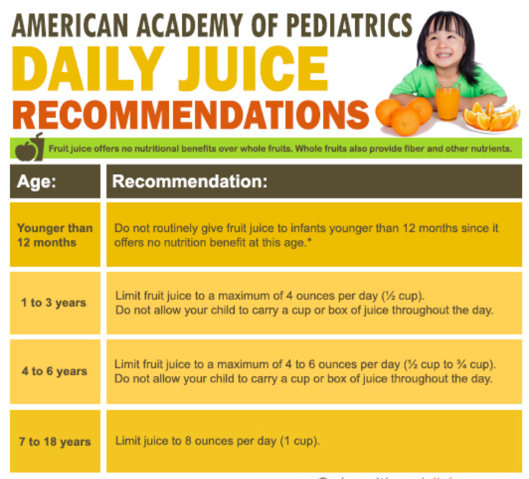
WIC guidelines follow these recommendations …
Notes:
57

Slide 58
ORAL HABITS
Drinking and eating are essential activities for the development of a child.
However, eating and drinking unhealthy foods can become a habit, which can pose a risk to the child.
Also, the inappropriate use of bottles, pacifiers and sippy cups can become a habit and also put the child at risk.
Notes:
58

Slide 59
ORAL HABITS
Bottle feeding
  If a infant/child continues to bottle feed too long, then the toddler may:
  Skip meals if he/she knows the bottle is available;
  Be exposed to nutritional deficiencies; and/or
  Experience childhood obesity, dental caries, as well as less than optimal craniofacial growth.
Thus, it is very important to wean a baby off the bottle.
Notes:
59

Slide 60
ORAL HABITS
Bottle feeding
  High frequency consumption of sugars by bottle-feeding, sippy cup use, or between meal consumption of sugars increases the risk of early childhood caries.
  AAP recommends weaning from the bottle between 12-24 months old.
  Prolonged use of a bottle containing anything but water may lead to early childhood caries.
  Prolonged use of a bottle may lead to poor adaptation of solid foods into the diet.
AAPD Reference Manual 2017-2018
Notes:
60

Slide 61
ORAL HABITS
Pacifiers
The American Academy of Pediatric Dentistry has published guidelines on the use of pacifiers and their influence on the developing dentition.
http://www.aapd.org/media/Policies_Guidelines/BP_DevelopDentition.pdf
Notes:
61

Slide 62
ORAL HABITS
Pacifiers
In general, the use of a pacifier should be discontinued by 36 months of age.
Extended use of pacifiers may pose a risk to the normal development of teeth and the face and might contribute to:
  Anterior open bite;
  Protruded upper permanent front teeth; and
  Narrow upper dental arch and/or crossbite.
Notes:
62

Slide 63
ORAL HABITS
Pacifiers
If an infant sees a dentist early, the dentist can monitor and, if necessary, help modify the use of a pacifier to reduce the risk of any adverse effect from its inappropriate use.
Notes:
63

Slide 64
ORAL HABITS
Sippy Cups
High frequency consumption of sugars by bottle-feeding, sippy cup use, or between meal consumption of sugars increases the risk of early childhood caries.
− AAPD Reference Manual 2017-2018
Notes:
64

Slide 65
ORAL HABITS
Foods
  Avoid processed foods high in sugars and carbohydrates in between meals.
  Fruit snacks, fruit roll-ups, gummy snacks, sticky candies, crackers, chips, pretzels are all high in sugars/carbohydrates.
  Promote healthy snacks such as appropriate servings of fruits, vegetables and cheeses.
Liquids
  Offer sugar-free/caffeine-free liquids (WATER) in between meals.
AAPD Reference Manual 2017-2018
Notes:
65

Slide 66
TOOTH GUIDANCE
Management of the Developing Dentition
and Occlusion in Pediatric Dentistry
http://www.aapd.org/media/Policies_Guidelines/BP_DevelopDentition.pdf
Notes:
66

Slide 67
Baby Teeth Guide
Eruption of Permanent Teeth
The first baby tooth usually appears in the mouth at about six months of age, and all 20 baby teeth have usually erupted by 3 to 6 years of age.
The shedding of baby teeth is a normal process as the underlying permanent teeth develop and begin to erupt.
The eruption of permanent teeth and the associated shedding of baby teeth normally occurs between ages 6 and 13 years.
http://www.aapd.org/media/Policies_Guidelines/BP_DevelopDentition.pdf
Notes:
67

Slide 68
Early Loss of Baby Teeth
Baby teeth can be lost early for a variety of reasons, among which the most frequent are dental caries and trauma.
Notes:
68

Slide 69
Early Loss of Baby Teeth
Early loss of baby teeth may cause shifting of the baby teeth, which can produce loss of space for the eruption
of the permanent teeth.
If this loss of space occurs, it can increase the risk of the permanent teeth becoming crowded upon eruption, which may require orthodontic treatment.
Notes:
69

Slide 70
Early Loss of Baby Teeth
If an infant sees a dentist for regular visits, then the dentist can better monitor the loss of baby teeth and the eruption of permanent teeth.
If an issue arises the dentist can take timely steps to mitigate the issue.
Notes:
70

Slide 71
SUMMARY
Oral health care is important for expectant mothers and is safe.
Infants need a dental home as soon as the 1st baby tooth erupts or the 1st birthday, whichever occurs first.
Good nutrition is important for oral health and overall health.
Oral habits can cause harm and need to be monitored and possibly modified.
Baby teeth are important to guide the eruption
of adult teeth.
Notes:
71

Slide 72
RESOURCES
The resources cited in this presentation provide additional information on the topics that were discussed.
Thank You
Notes:
72

